Slide 1
Exploratory Data Analysis of Housing Dataset
Krishna S DA /DS May 2025
Roll Number: 16525CBRE17

Slide 2
Introduction
The project focuses on analyzing housing data to uncover trends, patterns, and pricing drivers.
Objective: To understand key factors affecting house prices and provide data-driven insights for decision-making.

Slide 3
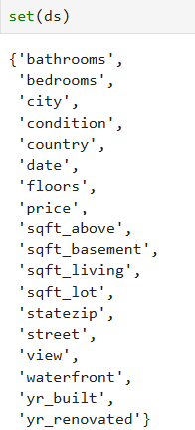
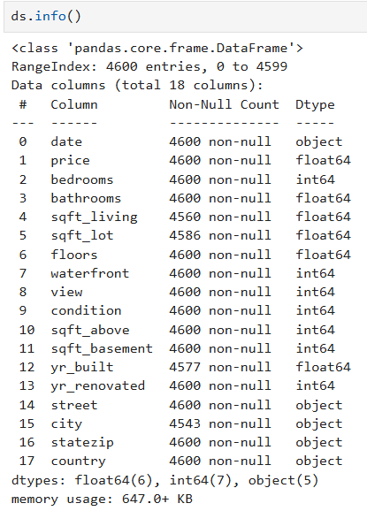
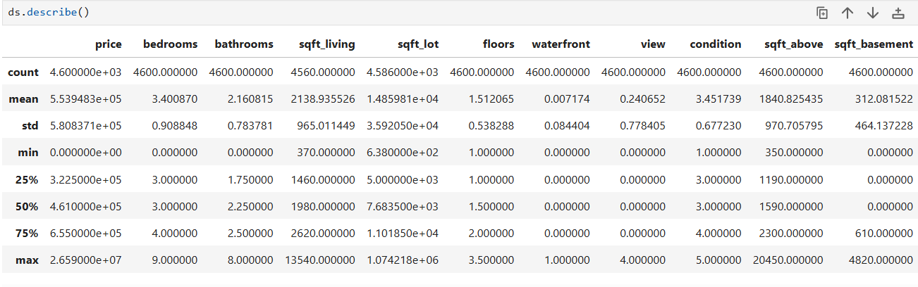
Data Understanding
Dataset: Real estate housing dataset containing thousands of property records.
Key Attributes: Price, bedrooms, bathrooms, sqft living, condition, view, waterfront, location (city, zip), year built, etc.

Slide 4
Data Cleaning
Steps Taken :
Handling Missing Values
Address inconsistencies
Handle categorical variables

Slide 5
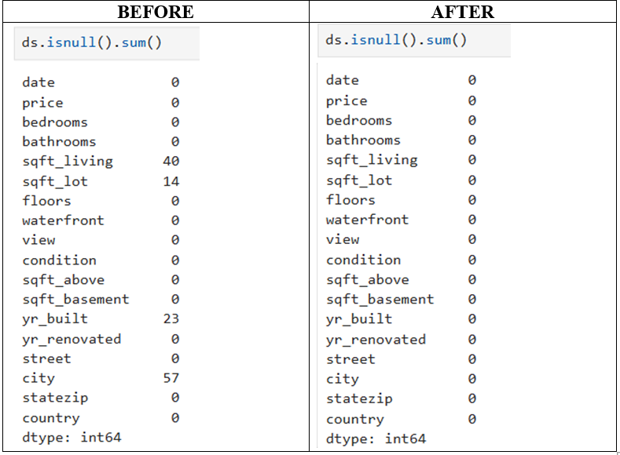
Handling Missing Values
Checked for null/missing values in critical columns.
Methods Used:
Mean/median imputation for numerical values
Mode for categorical variables
Row removal where data was not recoverable

Slide 6
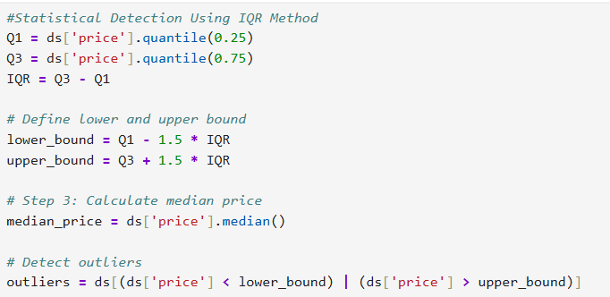
Outlier Handling
Identified using IQR and boxplot analysis
Replaced extreme values with median or removed based on business logic.

Slide 7
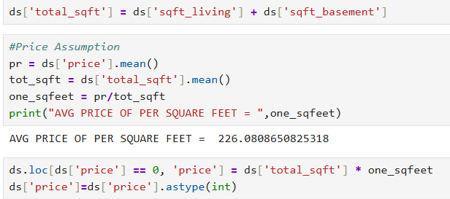
Handling Invalid Values
Filtered out properties with unrealistic values (e.g., 0 bedrooms, price = 0)
Corrected or excluded rows with invalid data entries.

Slide 8
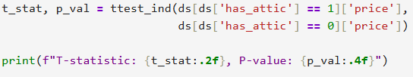
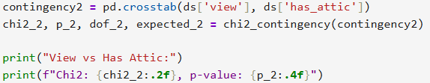
Statistical Analysis
Used descriptive and inferential statistics.
Conducted:
T-tests to check price difference based on attic presence
Chi-square tests to check categorical relationships (e.g., view and attic)

Slide 9
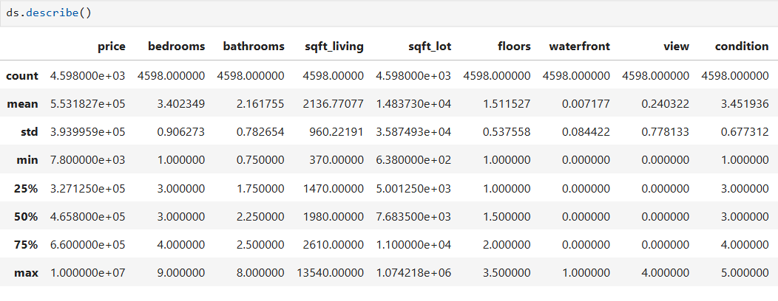
Descriptive Analysis
Summary statistics for all key variables:
Count, Mean, Std Dev, Min, 25%, Median, 75%, Max
Visuals : Histogram, Boxplot for price, sqft, condition, etc

Slide 10
Relationships Between Variables
Analyzed correlation between price and:
Bedrooms, bathrooms, sqft, view, condition
Tests Used: Pearson correlation, T-test, Chi-square test
Found strong links with sqft and condition

Slide 11
Data Visualization
Helped spot trends, distributions, and outliers.
Types Used:
Histograms
Boxplots
Bar charts
Scatter plots

Slide 12
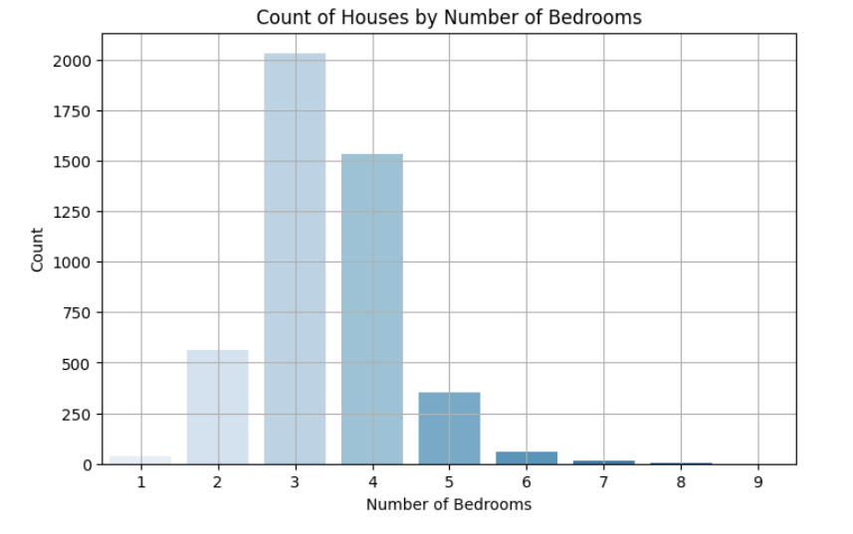
Univariate Analysis
Explored individual variables:
Price, sqft living, lot size, condition, year built
Visuals: Histogram for distribution, Boxplot for spread

Slide 13
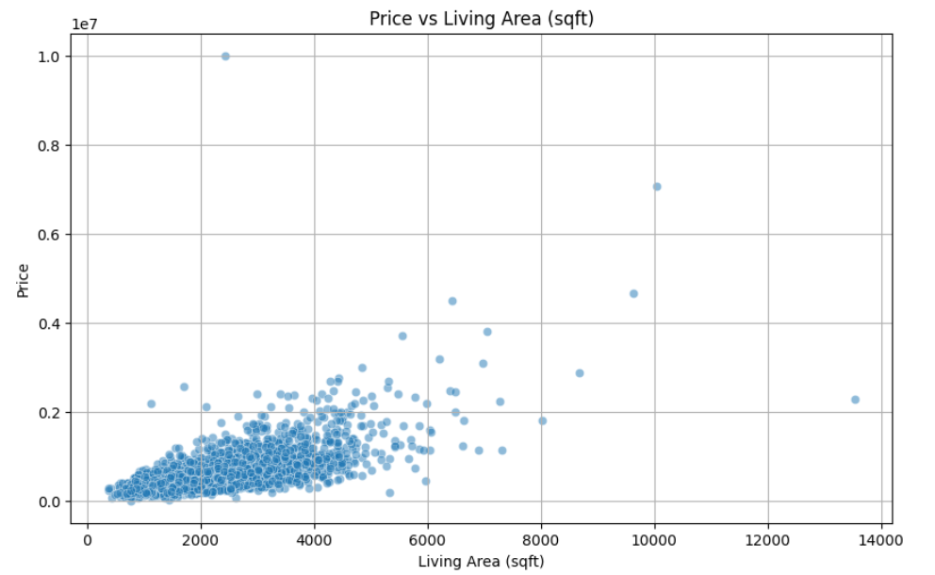
Bivariate Analysis
Explored two-variable relationships:
Price vs sqft living
Price vs bedrooms
City vs Price
Visuals: Scatter plots, Bar plots, Correlation heatmap

Slide 14
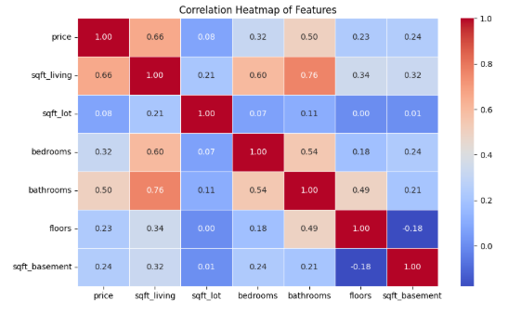
Multivariate Analysis
Examined combined influence of multiple features on price
Used:
Scatter matrix
Grouped bar charts
Cluster insights

Slide 15
Conclusion
Homes in better condition (4–5) have higher prices.
Higher view ratings are linked to increased property prices.
Properties with 3 to 4 bedrooms show the best price-to-size ratio.
More than 5 bedrooms do not significantly increase the price.
Larger living area generally leads to higher prices, but with more variation.
Medina has the highest average property prices, making it the most premium city in the dataset.
98039 (Medina area) is the most expensive zip code with the highest average property price.
Waterfront homes are significantly more expensive than non-waterfront ones.
Top Configuration: The most frequent type of property is 4 bedrooms with 2.5 bathrooms (572 properties).

Slide 16
Recommendations
Recommendations :
Target Medina (98039) for premium property development due to its highest average prices.
Focus on homes with 3–4 bedrooms, as they offer the best price-to-size ratio.
Build or market waterfront properties, since they command significantly higher prices.
Maintain or upgrade homes to condition ratings 4 or 5 to boost property value.
Promote homes with good views, as higher view scores are linked to higher prices.

